Slide 1

The tech devils
Sprint demo 3
Notes:
Good evening all, welcome to team 3, the tech devils sprint demo,
* Introduce the team and tasks per person
* Don’t forget to introduce miss pu as product owner

Slide 2
Table of contents
Description
Team Progress
Live demo
Issues
Priorities
questions
Notes:
Our topics today are as follow:
* Read from the list in the slide or memorize them

Slide 3
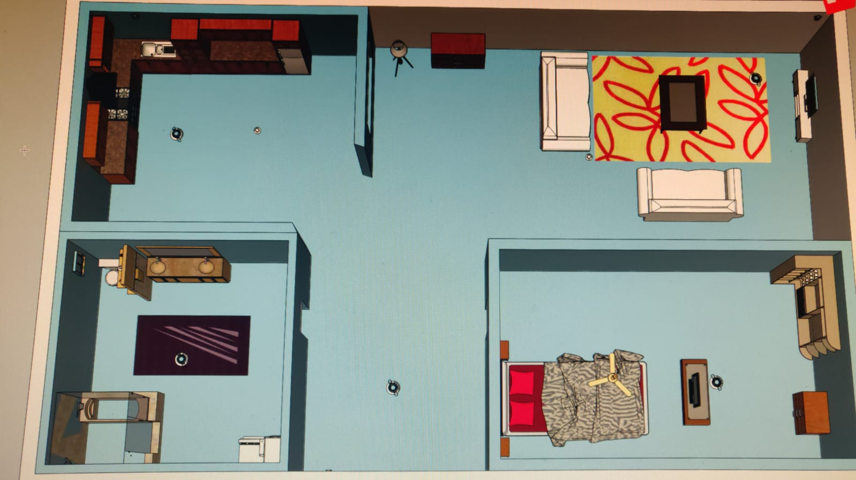
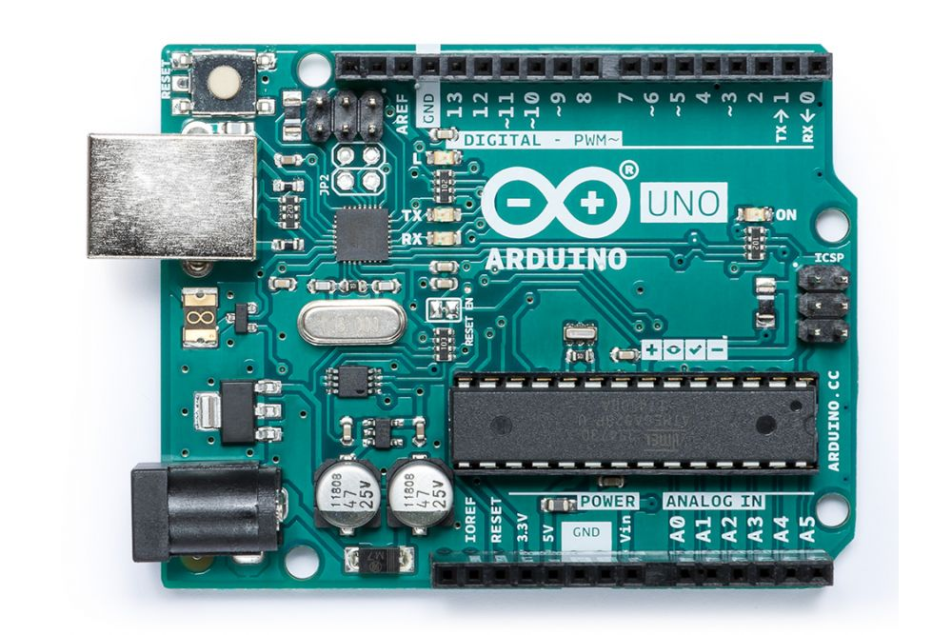
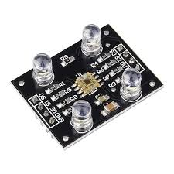
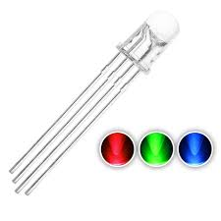
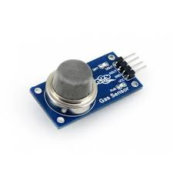
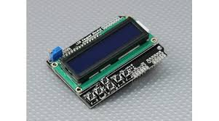
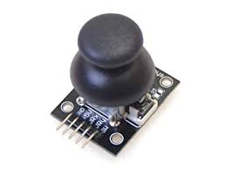
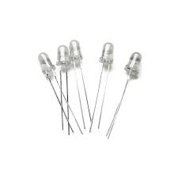
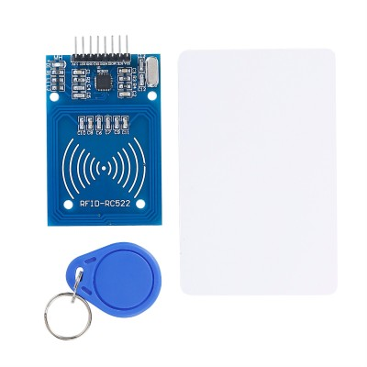
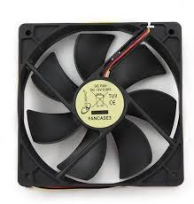
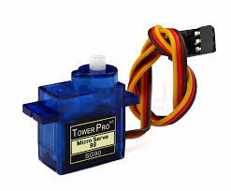
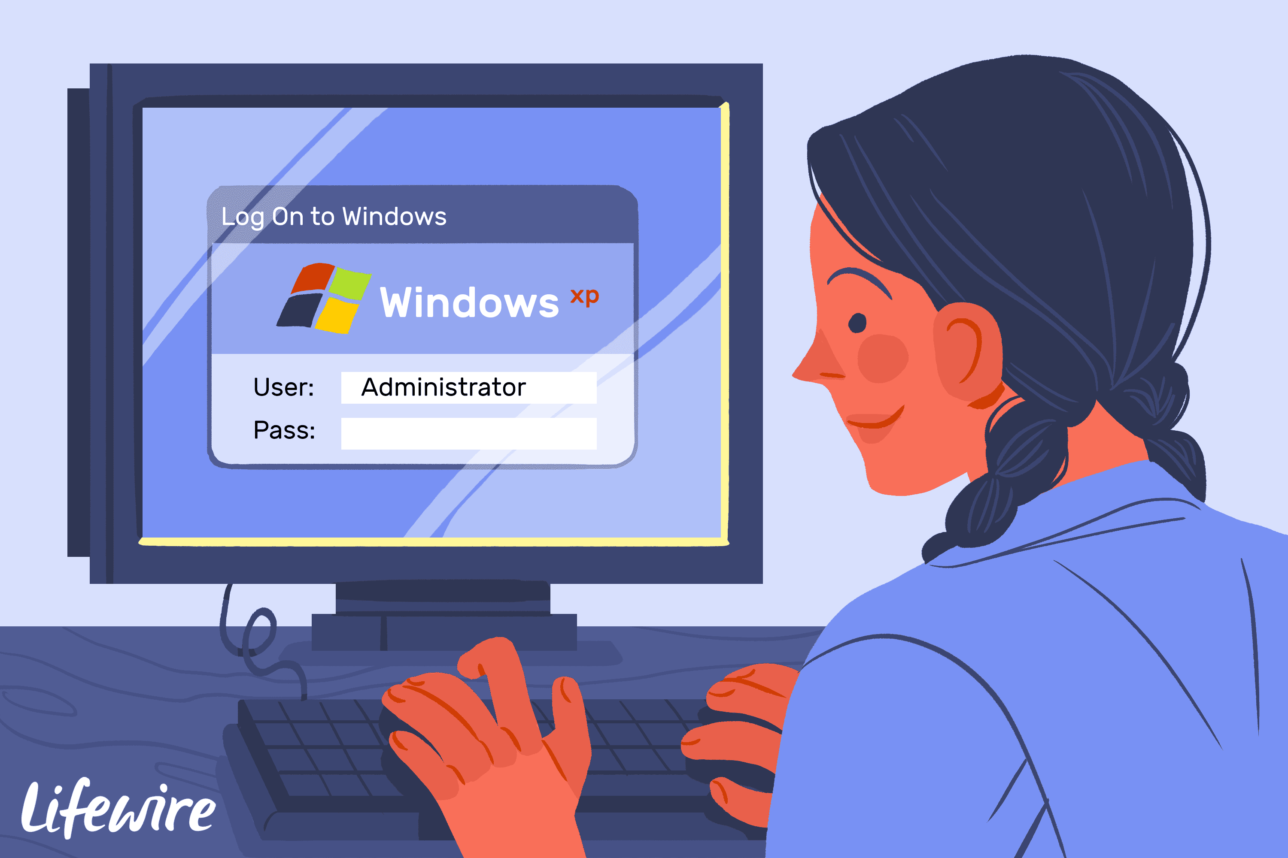
description
How do the Individual systems work?
How they work together.
How does the door system communicate with the administrator system

Slide 4

Live demo
Notes:
Do a live demo & show my video of the kitchen system

Slide 5
issues
Communication between the Arduino’s and the administrator system
Improper timing

Slide 6
priorities
Making the systems communicate with each other
Finishing the administrator system prototype

Slide 7
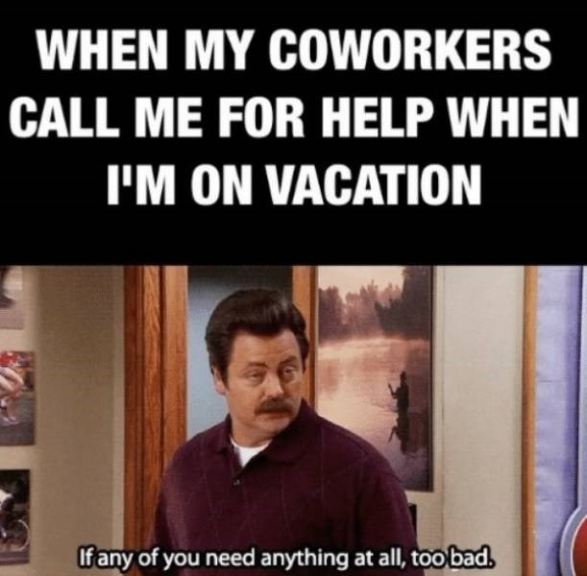
questions

